Slide 1
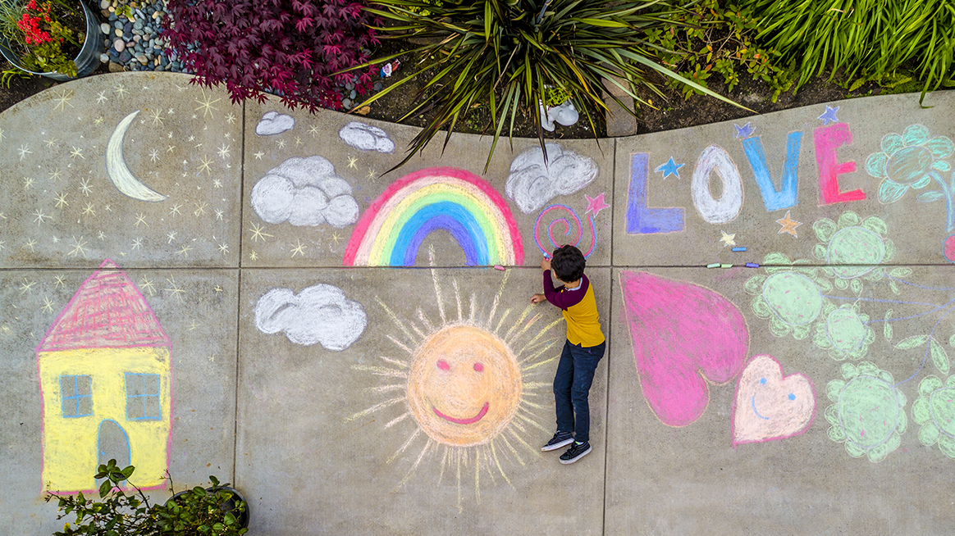
Digital users as producers of knowledge
Content creation: storytelling for community engagement and representation

Slide 2
What impact does digital storytelling/ online content have?
Constructs meaning
Creates connections
Influences perceptions of communities

Slide 3
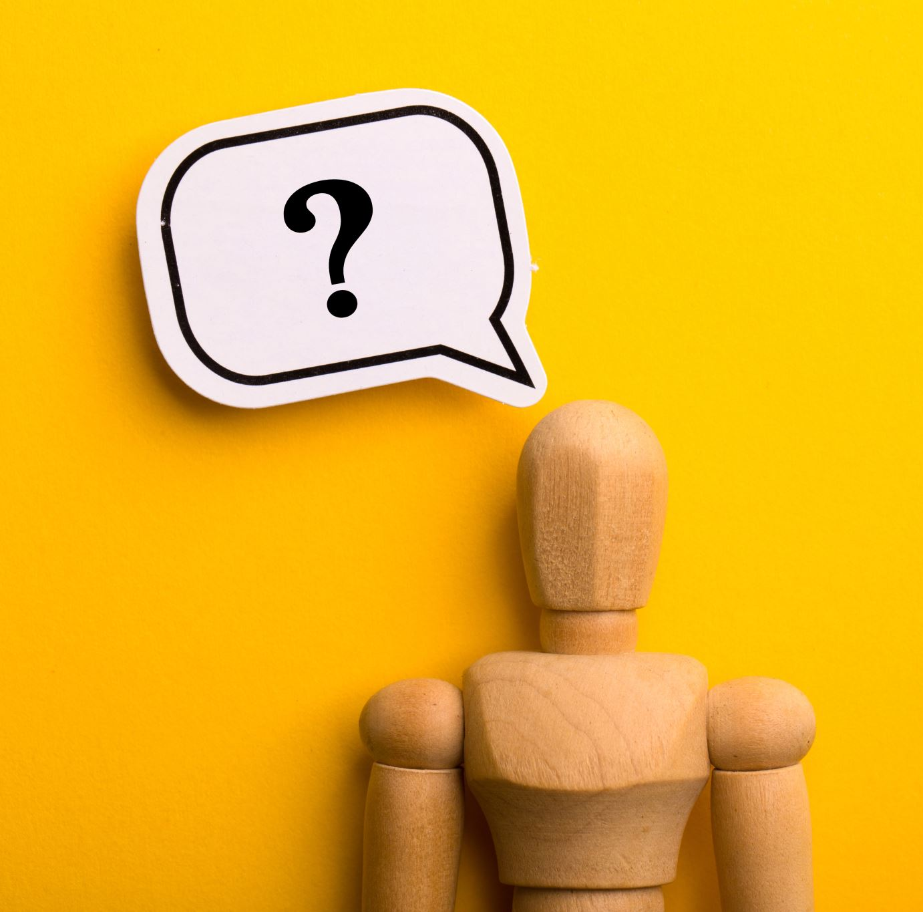
Where do you currently create content, and under whose rules?

Slide 4

Digital content as storytelling
All digital content tells a story:
About the creator
About others
About the world
About what is under focus

Slide 5
Content creators are producers of meaning: content creation involved
Representation and Voice
Negotiating norms
Managing visibility

Slide 6
Examples of storytelling
Youtube video
Blog post
Podcast
Instagram
Etc.

Slide 7
Elements of storytelling
Narrative/plot (beginning, middle, end)
01
Voice and perspective (whose voice? What angle is the story taking?)
02
Audience (who is it for?)
03
Medium and format (what mode of presentation: audio, video, photography?)
04
Emotion and meaning (what is aimed at with the story?)
05

Slide 8

Whose story is being told, and whose might we be missing?

Slide 9



The power of storytelling
Stories can:
  Empower
  But they can also exercise power to:
  Silence
  Reinforce stereotypes
Need to be conscious of what to post

Slide 10
When planning content creation:
Avoid:
Stereotyping
Simplification
“Single story” narratives
Aim for:
Complexity
Diversity
Agency

Slide 11

Identity a viral story
Who benefits from its visibility?

Slide 12

Platforms are not neutral
Algorithms shape:
  Visibility
  Engagement
  Success
Metrics influence creative choices

Slide 13

Economy of attention
Likes, shares, views as currency
Pressure to:
  Perform
  Simplify
  Sensationalise

Slide 14
Reflection point
How do metrics and desire for visibility influence what you would create?

Slide 15
Ethical creator mindset
Why am I creating this?
For whom?
On which platform?
What might be the unintended effects?

Slide 16
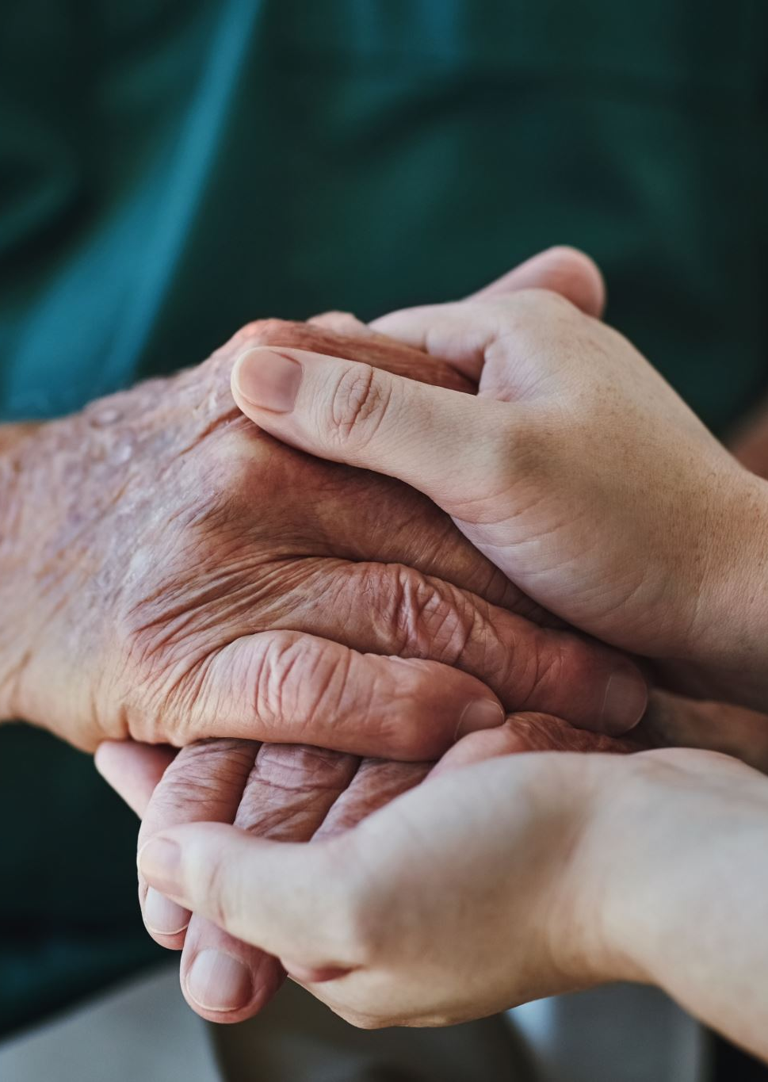
Ethics of digital creation
Ethics involves:
Responsibility: whose interests are served
Respect: is informed consent sought?
Accountability: what might be the consequences of giving visibility to the community?
Not just “Can I?” but “Should I?”

Slide 17
Ethical considerations
Representation of others
Consent and privacy
Accuracy (staying way from misinformation)
Cultural sensitivity
Attribution (avoiding plagiarism)

Slide 18

A scenario to discuss
A content creator posts a “funny” video about the community centre in your town, including opinions that are presented as facts.
Discussion:
Is consent required?
Who is harmed?
Who benefits?

Slide 19
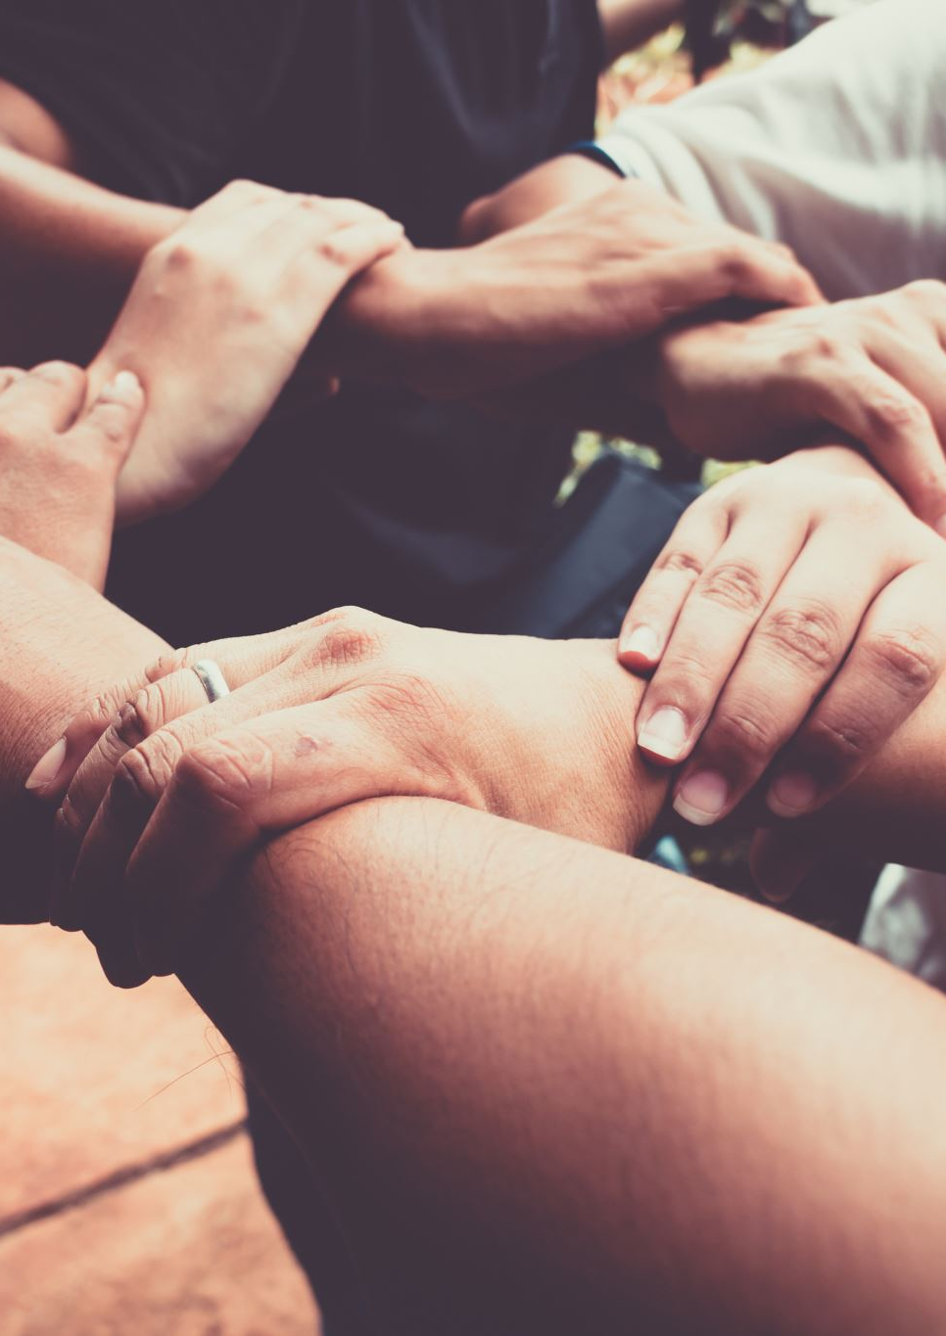
Safety as a key digital practice
Safety is not just a technical feature one can activate; it is a social and emotional experience
It includes:
Digital footprints: we leave or create on behalf of others via the content we publish
Online harassment: which can start as a provocation, an opinion, or a funny joke
Data privacy: disclosure of our as well as others' private information
Emotional and affective work: the emotional injuries we can cause others because of the content that they post affect us (psychologically)

Slide 20

Create with care
Plan a piece of digital content (concept only):
Topic of your choice
Platform of your choice
Define audience

Slide 21
Storytelling elements
Clear purpose & message
Strong opening
Emotional resonance
Respectful framing

Slide 22

Your content must include:
A clear story
Ethical consideration
Safety decisions
Reflection on platform influence
Format options:
Storyboard
Script
Post outline
Podcast concept

Slide 23

Points of reflection
What choices did you make and why?
  Why this story?
  Why this format (video/audio)?
  Who is represented and how?
  What care practices are needed?

Slide 24
In summary
Digital creation has social, cultural and emotional implications
Storytelling involves power – be mindful of who is empowered and who might be disempowered
Ethics and safety are creative decisions
Content creators should reflect, question, and adapt

Slide 25

Final question
What responsibility do you have as a digital content creator?

