Slide 1

Leading and engaging communities online
Building confidence, participation, and shared purpose

Slide 2

What matters in digital communities?
List ideas from your own perspective

Slide 3
What matters in digital communities
People learn with and through each other
Digital spaces extend opportunity to connect, learn, be …
Collaboration to foster engagement and new opportunities
Leadership in digital spaces is distributed, not top-down
A strong sense of belonging (constructed over time)
Shared history (via a shared portfolio)

Slide 4
Online communities
…connected by a shared purpose
… interact regularly via dedicated online spaces
… committed to developing shared practices, resources, language
… support one another’s growth and learning
… co-create value for self and the collective

Slide 5

What does leadership of online communities mean to you?

Slide 6
Leadership in a digital community
Facilitating participation
Encouraging collaboration
Modelling ethical engagement
Supporting newcomers
Enabling shared ownership

Slide 7

How to foster shared purpose?
A community develops when members:
Come together over a shared interest
Feel emotionally and professionally invested
See the value of contributing to it

Slide 8

Building trust and cognitive safety
Trust and safety can be fostered by leaders by:
Scaffolding engagement
Modelling respect and empathy
Encouraging questions and curiosity
Normalising mistakes as part of learning
Showing appreciation for contributions
Setting rules of engagement

Slide 9
Enabling activity (member contributions)
Establish a shared curriculum: negotiate what the community wants to achieve and agree on roles
Create social activities to animate/start off interaction within the community
Invite contributions directly
Create multiple forms of engagement (low to high level engagement)

Slide 10
Encourages a shared portfolio of practice
Digital communities develop shared:
Routines
Vocabulary
Tools
Stories
Norms
Artefacts (guides, templates, resources)

Slide 11
Leaders help build the shared repertoire by:
Encouraging knowledge exchange
Documenting collective learning
Making resources accessible to other as a way to show value of contribution

Slide 12
Leading through facilitation through a stewarding culture
Enabling rather than directing
01
Amplifying voices rather than concentrating participation in a few members
02
Connecting people to resources and each other
03

Slide 13
Establishing principles of shared practice
Respectful communication
Crediting sources and creators
Awareness of privacy and consent
Accurate, responsible information sharing
Shared understanding

Slide 14
Grwoing the community; welcoming new members
Welcome new members intentionally by providing:
Clear orientation
Low-pressure participation opportunities, with opportunity to grow into bigger roles
A buddy or mentor system
Encouragement and visibility

Slide 15
Strategies to get the community going
Structured discussions and prompts
Tackling Community challenges or campaigns
Shared knowledge creation and/or aggregation
Collaborative projects

Slide 16
Preparing to lead: create your community plan
What will the community focus on/ be about?
Who are the “starter” members, people who are committed to your vision who can drive interest and engagement?
What activities will you devise to help them ‘gel’ with each other and build trust and shared purpose?
What will you do to sustain that initial enthusiasm?
What roles will different members have?
Which digital platforms will you use and why?

Slide 17
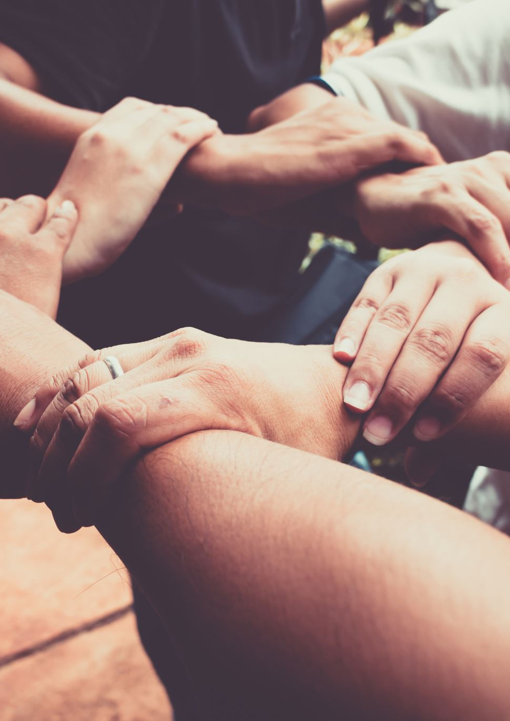
Once the community is set up
How will you devise the rules of conduct/ social contract of the community?
How will you welcome a new member?
How do you respond when discussion becomes unproductive?
How would you encourage a silent/quiet member to engage?
How would you handle misinformation shared by a member?

Slide 18
Design an engagement plan for your digital community including:
1 community challenge
2 conversation prompts
1 collaborative task
1 resource-sharing activity
A plan to recognise contributions

Slide 19

5 leadership rules
Build trust and purpose
Enable forms of participation
Model ethical digital behaviour
Facilitate shared practice
Support community ownership

Slide 20
The 5 Ps of leadership in digital communities
People
Participation
Practice
(shared) Practice
(em)Power(ment)

Slide 21

What will your digital community be focused on?

