Slide 1

Healthy online relationships and wellbeing

Slide 2

What does a healthy online relationship mean to you?

Slide 3
Foundations of healthy online relationships
Technology shapes our experience and in turn we shape the design of technology
Digital relationships are impacted by platform norms, algorithms, and the social expectations that are created in these spaces:
Can you think of any?

Slide 4
Digital wellbeing
How digital technology and the digital experiences it enables impact on our sense of self
Connected to digital citizenship
Happiness
Safety
Competence
Self-worth

Slide 5
What problematic behaviours can people encounter of be part of online?
How do you think these behaviours affect their sense of self and that of others?

Slide 6

Digital wellbeing
Often juxtaposed against undesirable digital practices
Risks
  Content
  Contact
  Conduct
Bjorn Nansen, Kabita Chakraborty, Lisa Gibbs, Colin MacDougall & Frank Vetere (2012) Children and Digital Wellbeing in Australia: Online regulation, conduct and competence, Journal of Children and Media, 6:2, 237-254, DOI: 10.1080/17482798.2011.619548

Slide 7
Social expectations of being online
Contant availability (always being ready to respond)
Continued productivity or visibility (new posts all the time to stay relevant)
Performing happiness or success (unrealistic lifestyles, such unboxing, wealth, body building, etc.)
Moral public performance (pressure to publicly signal virtue rather than practice genuine, private ethics)
Perfection (hinting at comparisons with one’s lifestyle and life circumstances)

Slide 8

Models of cyber-safety
Tend to follow a risk-protection and functional model

Slide 9
Rather than focusing on
Conduct
competence

Slide 10

How might we think differently about digital wellbeing – beyond the technical and risk management ways?

Slide 11
Reframing online relationships
From participation to recognition
Online relationships are not just about engagement but about being seen, heard, and valued
Key to relationships is reciprocity

Slide 12

Interpersonal recognition as the basis of healthy online interactions
3 principles:
Care (emotional recognition): empathy, respect, psychological safety in interactions
Rights (moral recognition): boundaries, consent, freedom from harassment
Esteem (social recognition): valuing diverse contributions beyond metrics (likes, followers)
Application online:
Healthy interactions support dignity, not popularity
Wellbeing depends on we giving and receiving recognition (social validation), not enhancing our visibility

Slide 13
Managing conflict online
Use conflict as a learning site, not as a personal attack
1
Online conflict often reflects people’s own fears or misunderstanding
2
Shift from personalization (“I am attacked”) to contextualization (“What is intended here?”)
3

Slide 14
Healthy practices (that work both ways):
Slow responses (reflect if an answer is needed. Can the answer be to ‘disconnect’ from that interaction? Or engage in respectful dialogue?
Distinguishing disagreement from disrespect (different opinions are allowed; personal denigration is not)
Refusing algorithm driven outrage (consciously choosing not to let platform algorithms dictate your emotional reactions, attention, or participation in online conflict).

Slide 15

Establishing boundaries
Resisting toxic expectations of constant presence
Boundaries are acts of agency, not withdrawal
Emotional resilience = capacity to withstand misrecognition without internalising it
Wellbeing grows when individuals can opt out without penalty

Slide 16
Discuss
How do boundaries become acts of agency?

Slide 17

Healthy and safe boundary practices:
  Choosing when and how to engage
  Limiting emotional labour
  Protecting private self from public performance

Slide 18
Toward wellbeing oriented digital culture
From individual coping to collective responsibility
Move beyond “digital self-care” to structural change
Being part of the change you want to be
Healthy online relationships emerge when we recognise ourselves as well as others as worthy human being (entitled to rights, respect and social support regardless of age, social status, ethnicity, gender, etc.)

Slide 19
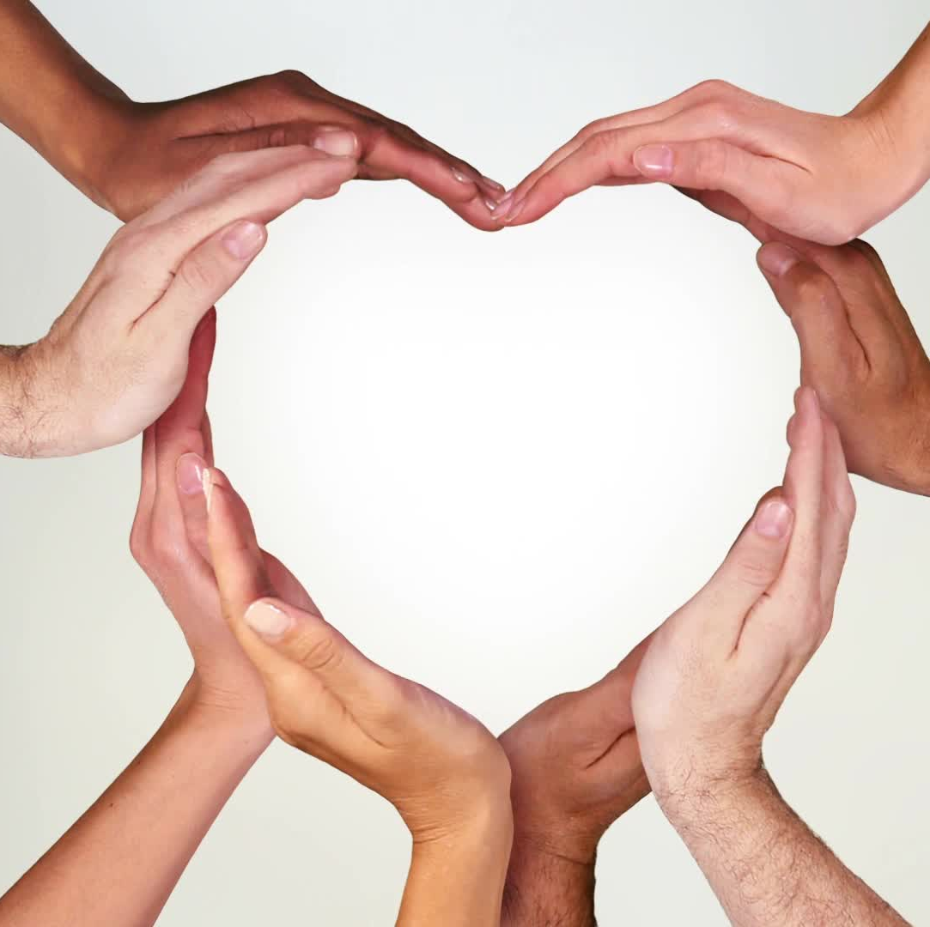
Can the roots of wellbeing be restored?
Root of love: re-learning to trust and care.
  (Self-)empowerment: being kind to others/ourselves; not letting others affect self-confidence
Root of rights: Claiming equal treatment
  (Self-)empowerment: making voices heard; setting boundaries and standing up for mistreatment of self/others
Root of solidarity:
  (self)empowerment: celebrating uniqueness in community. Search for your tribe and value.

Slide 20
Forms of relating to self | Contexts: ways of relating to self | Forms of recognition | Action: | Forms of disrespect
Self confidence | Friendship Love | Attachment of love and care | Caring for someone | Neglect Abuse
Self-respect | Autonomy of individual (with rights) | Legal rights | Recognition of legal rights | Violation of rights (legal, civil, human, employment, etc.)
Self-esteem | Freedom and autonomy through work | Community respect and solidarity | Recognition of one’s contribution | Bullying, ignoring, excluding, constant negative feedback

Slide 21

Rules of Thumb” for healthy online relationships
List yours
What would online spaces look like if well-being, not engagement, were the goal?

