Slide 1
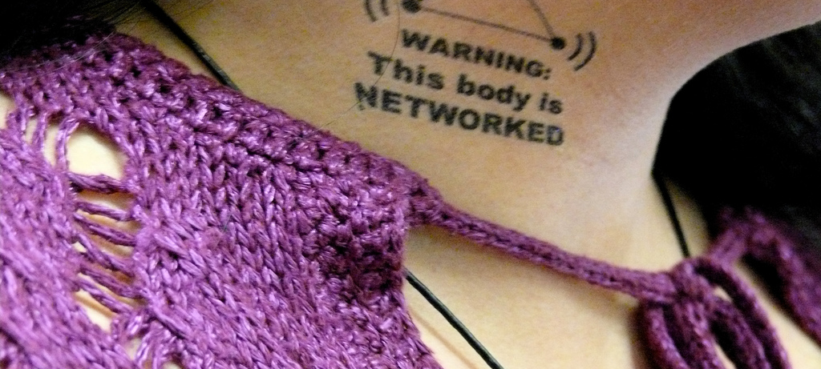
Digital citizenship and digital identity (footprint)
What is it?

Slide 2
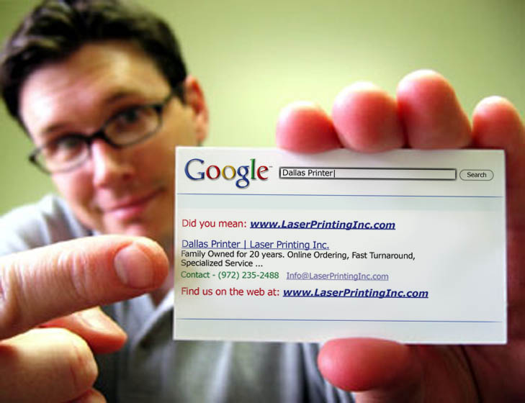
Have you ever Googled (searched) yourself (online)?

Slide 3
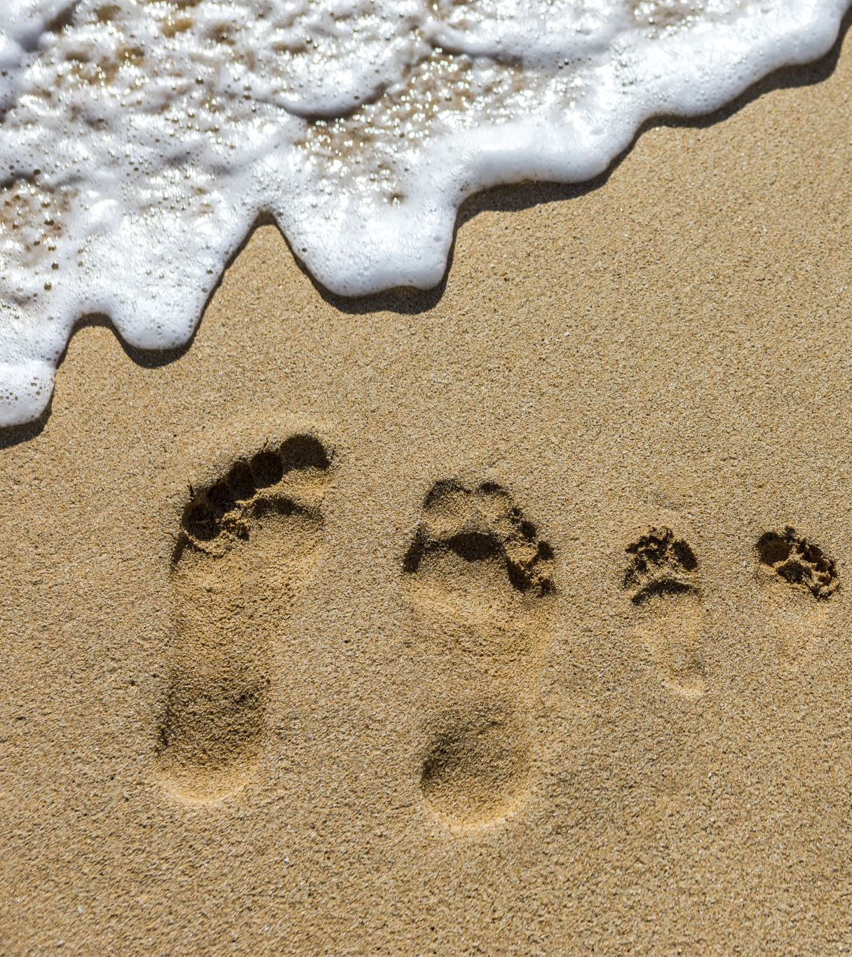
Does your digital footprint represent you well?

Slide 4
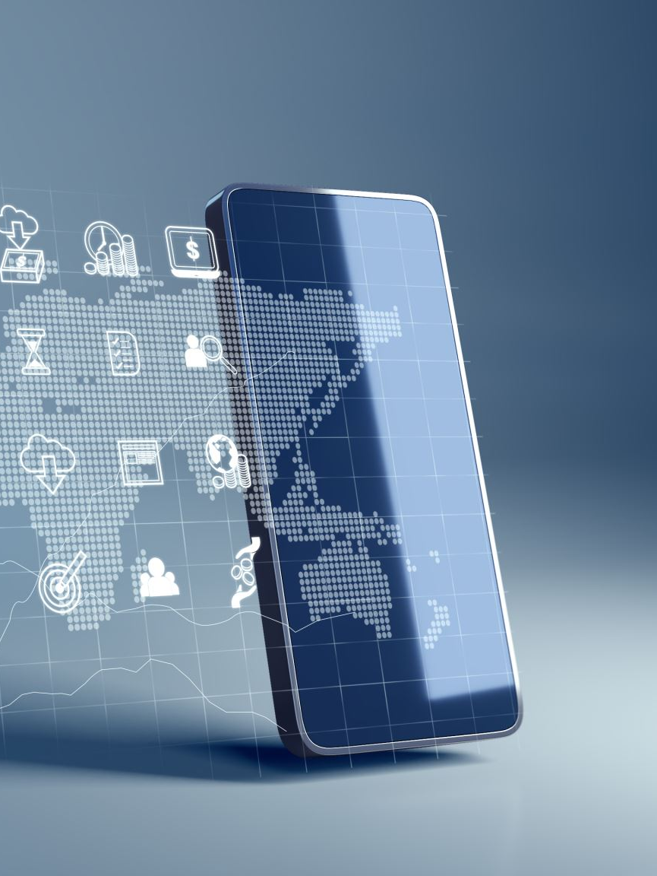
Revisit your footprint
Close your laptops/put away your phones
Draw a timeline of your engagement with the web and your digital practices
List the accounts you have created throughout the years
Consider the sites/networks where you have participated (those that you no longer use and those where you are still active)
Reflect on how they represent you (what usernames to you use? What type of content did you produce? What type of discussions did you engage in?)

Slide 5
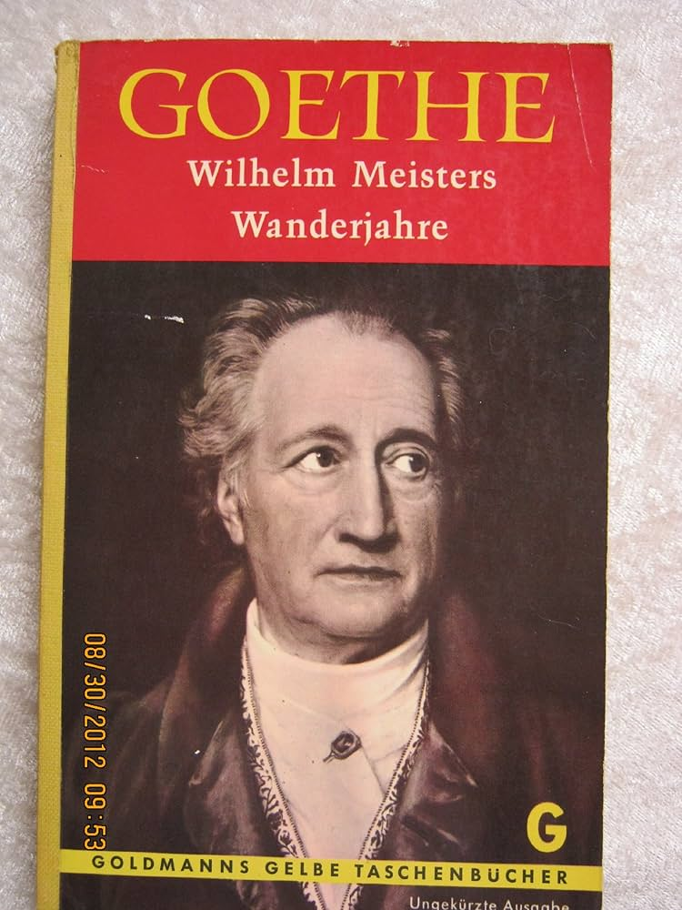
“Sage mir, mit wem du umgehst, so sage ich dir, wer du bist; weiß ich, womit du dich beschäftigst, so weiß ich, was aus dir werden kann”. - Johann Wolfgang Goethe, Wilhelm Meisters Wanderjahre
“Tell me with whom you associate, and I will tell you who you are; if I know what you occupy yourself with, I know what you can become”. - Johann Wolfgang Goethe, Wilhelm Meister's Years of Wandering

Slide 6
What is digital identity?
More Than a Username
The sum of your online presence: profiles, posts, interactions, data
Shaped by platforms, algorithms, and social norms
Not just self-expression, also surveillance, commodification, and control

Slide 7
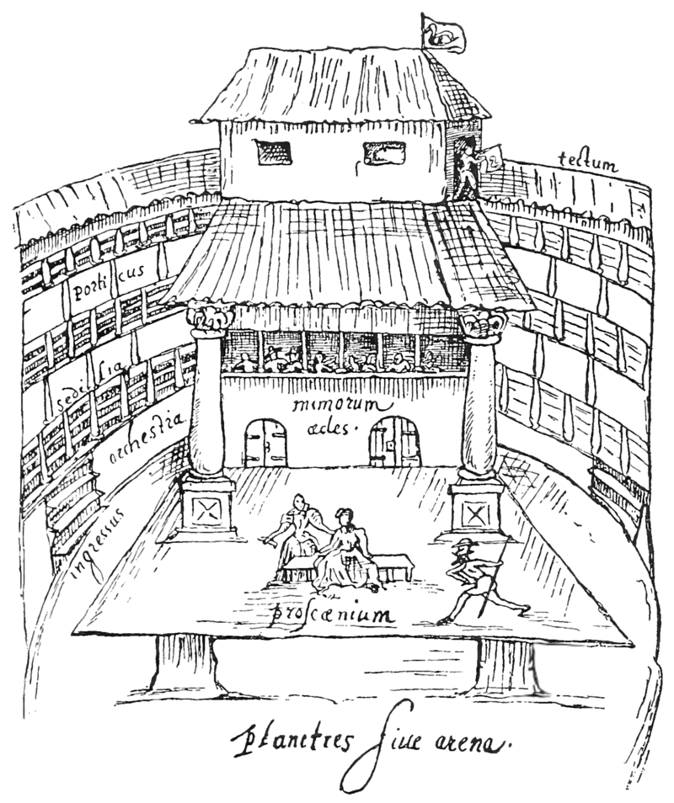
Is the web a stage?
All the world’s a stage,
And all the men and women merely players;
They have their exits and their entrances
By William Shakespeare
(from As You Like It, spoken by Jaques)
Picture CC . Source Wikimedia: https://en.wikipedia.org/wiki/English_Renaissance_theatre#/media/File:The_Swan_cropped.png
Notes:
In
The Presentation of Self in Everyday Life
,
Goffman
(1959)
focuses on the
importance of everyday, face
-­‐
to
-­‐
face interactions between people. To Goffman,
personal interaction is based on performance and a relationship between actor and
audience wherein there is an agreed
upon definition of the situation

Slide 8
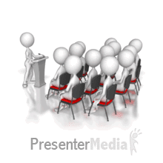
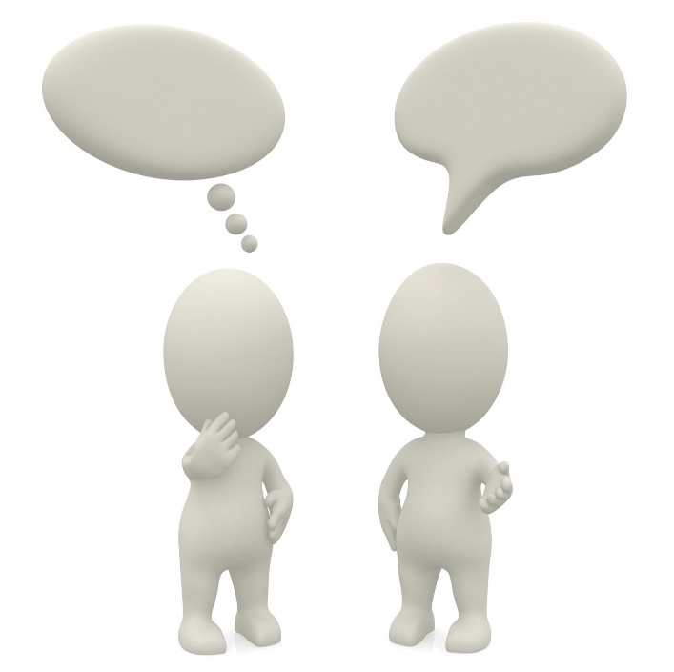
Impression management
Front Stage
Backstage
Barrier
Dramatic interaction
Informal
Relaxed
Private
Notes:
back stage in which the individual has a private place where they can stop performing and rid themselves of their role or social identity and be their true self
(Goffman 1959:129)
Impression management: expressing certain information in order to impress certain ideas upon an audience during social interaction
Backstage – where the hidden parts of our personality can make an appearance
Place where the performance is liberated from the audience and their expectations
Backstage is meant to be hidden from the audience

Slide 9

Goffman
Interpersonal interaction as an embodied performance
Impression management
  ‘impressions’ of oneself are created through one’s ‘expressions’
  Frontstage and backstage
Notes:
The Presentation of Self in Everyday Life, Goffman [1] analyses interpersonal interaction and how individuals 'perform' in order to project a desirable image, using the theatre to illustrate individuals’ contrasting front stage and back stage behaviour
Displays different masks
Play a range of diff parts determined by situations
We adapt who we are dependently who we are interacting with

Slide 10
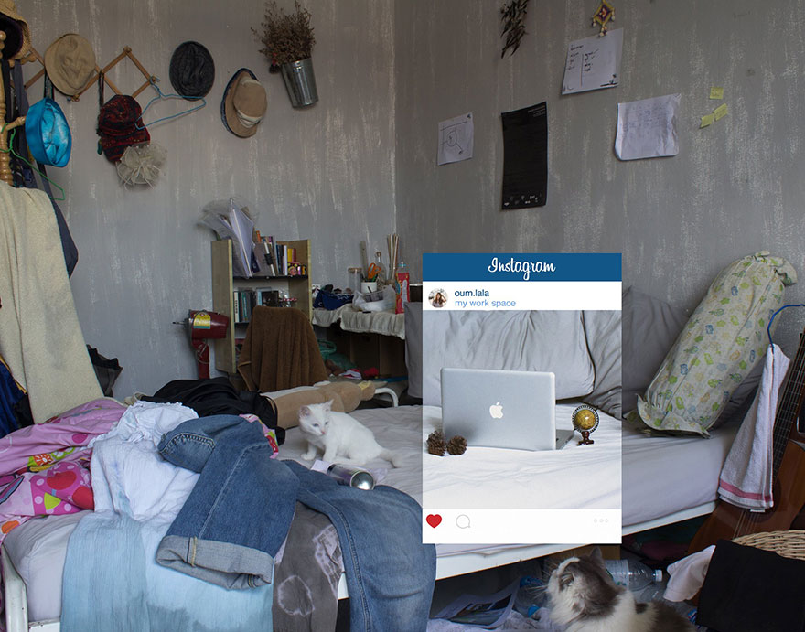
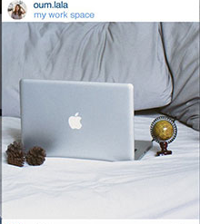

Slide 11
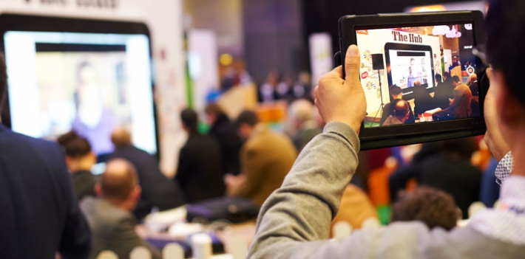
We not only (re)present
We are also (re)presented
Photo CC: https://www.jisc.ac.uk/blog/spring-and-summer-events-2016-24-nov-2015

Slide 12
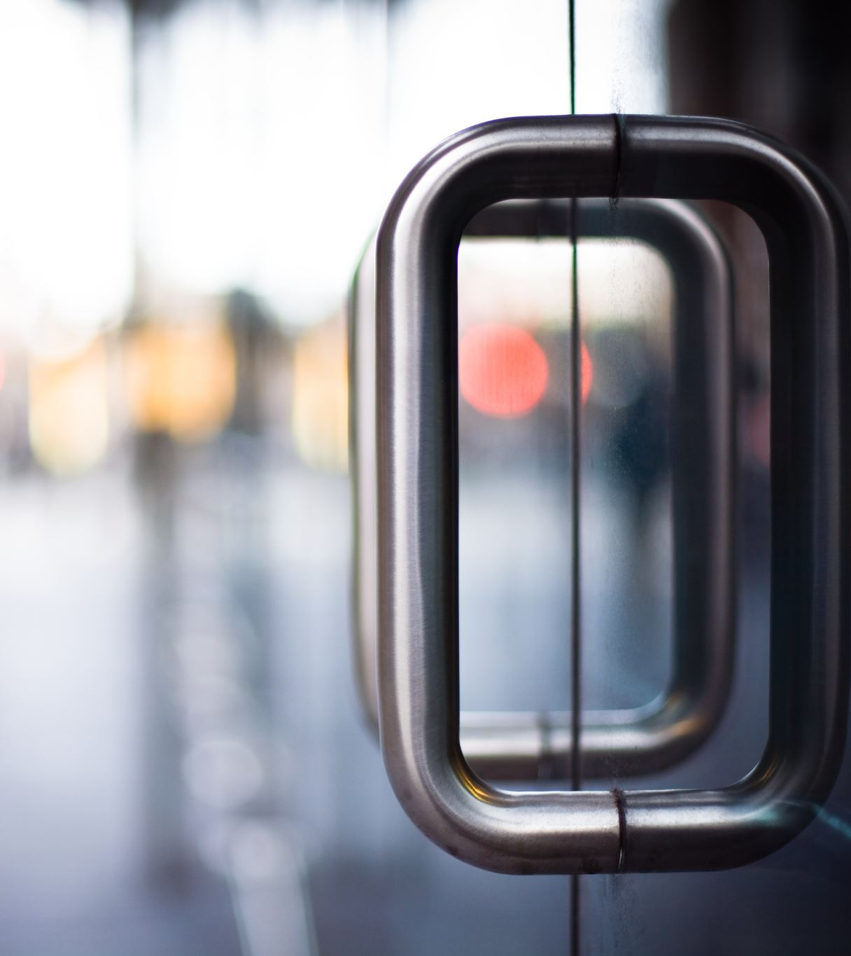
Blurred boundaries
Privacy and public(ity)
(often misunderstood)
Public by default, private through effort (boyd, 2014)

Slide 13









Professional
Tools
&
Practices
Private
Public
Personal
Notes:
Move the icons around, delete the ones you don’t use, add in ones that you do.

Slide 14
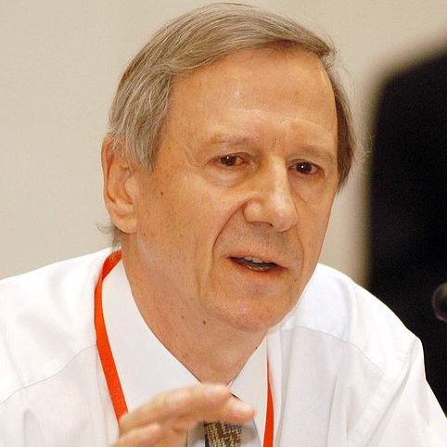
Changing nature of identity (fluid identity), self-identity including self-reflexivity and creating biographical narratives (project of the self) as an inescapable issue in post-traditional societies (Giddens, 1991)
Need for curation of image

Slide 15
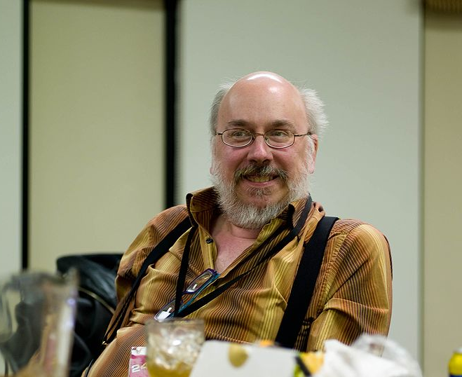
Identity expression in digital media is part of community involvement, which in itself provides strong incentives for creative expression and active participation in terms of a “participatory culture”
Jenkins, 2007

Slide 16

through the looking glass
A closer look

Slide 17
What to look for?
Authenticity??? (cross checking information)
Networks one is associated with
Quality of ‘friends’ and interactions
Profile information (coherence)
Quality of content (beyond aesthetics and into intentions)
Regularity of publication of content
Etc

Slide 18

Digital identity
Questioning the System
Challenges assumptions about neutrality and objectivity
Asks: Who benefits from how identity is constructed online?
Centres marginalised voices and lived experiences
Encourages reflection, resistance, and transformation

Slide 19

Young People and Digital identity
Navigating a complex digital terrain
Pressure to perform and conform
Identity experimentation vs. digital permanence
Platform norms: TikTok, Instagram, Snapchat—each with different rules of selfhood

Slide 20

The politics of visibility
Who gets to be seen?
Algorithms prioritise certain aesthetics, behaviours, and voices
Marginalised identities often suppressed or tokenised
“Authenticity” is curated and commodified
What does it mean to be “real” online?

Slide 21
Surveillance and Control
Your footprint is being captured
Data mining: your identity is a product
Facial recognition, behavioural tracking
School platforms monitor student behaviour (subjectification)

Slide 22
Barriers to authenticity:
What gets in the way?
Barrier | Impact
Platform norms | Pressure to conform
Surveillance | Fear of being watched
Algorithmic bias | Unequal visibility
Cultural expectations | Identity policing

Slide 23
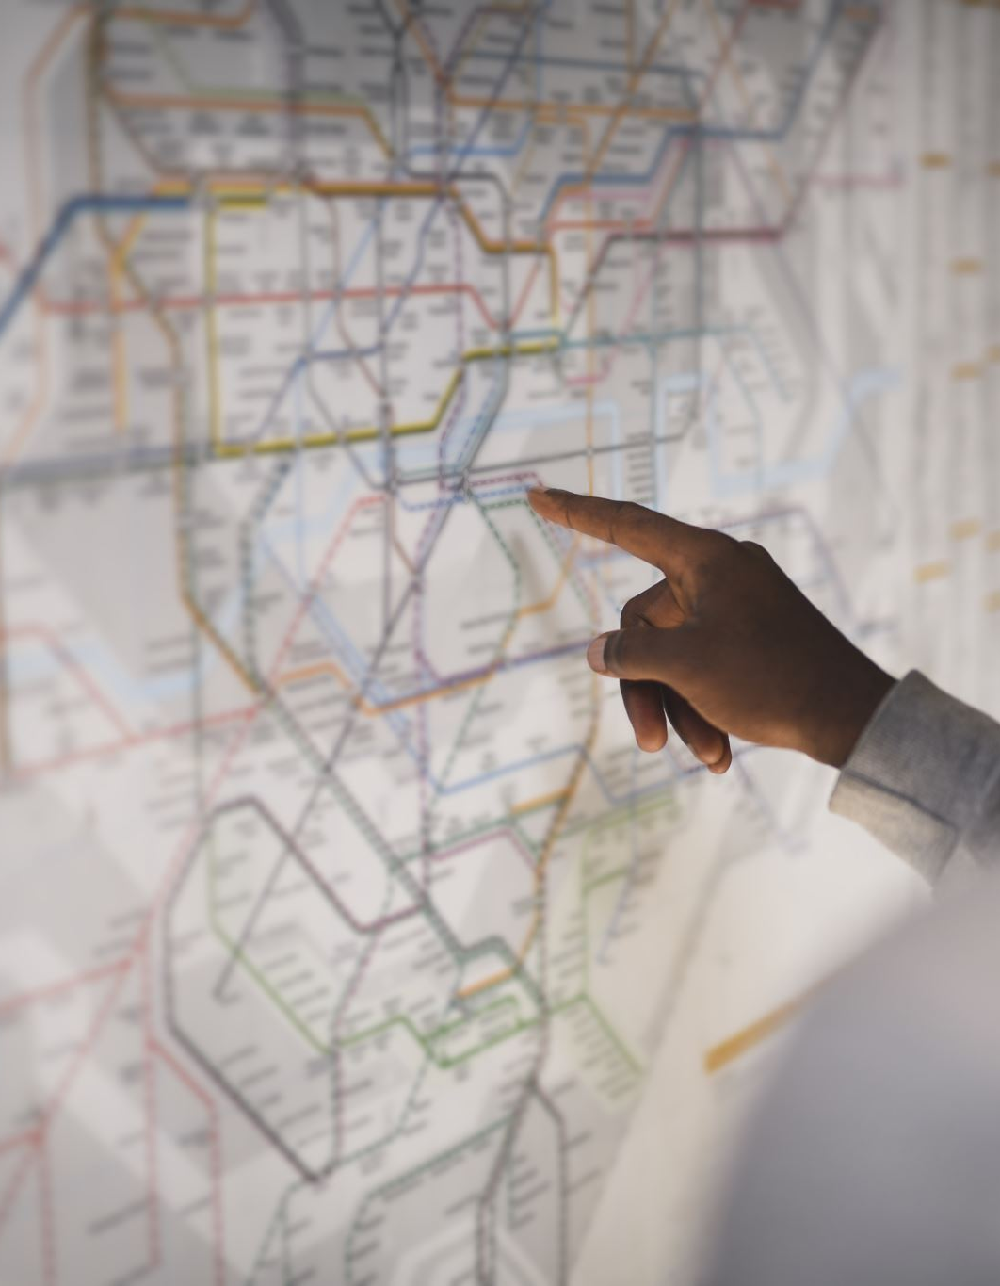
Activity – Identity mapping
Who Are You Online?
Based on the timeline you created reflect on your digital identities across platforms
What parts of you are amplified? Hidden?
What would a platform look like if it truly supported your full identity?

Slide 24
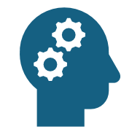
Critical Digital Literacy
Constructing a digital identity
Recognise algorithmic bias
Understand platform politics
Practice ethical self-representation
Build inclusive digital communities
Advocate for digital justice

Slide 25

How can we help others understand/explore their digital identity?

Slide 26
Readings
boyd, danah. (2014). It’s Complicated: The Social Lives of Networked Teens. Yale University Press.
Giddens, A. (1991). Modernity and Self-Identity: Self and Society in the Late Modern Age. Stanford University Press.
Jenkins, H. (2007). Confronting the challenges of participatory culture: Media education for the 21st century (Part One). Nordic Journal of Digital Literacy, 2(1), 23–33. https://doi.org/10.18261/ISSN1891-943X-2007-01-03
Rowland, J., & Estevens, J. (2025). “What is your digital identity?” Unpacking users’ understandings of an evolving concept in datafied societies. Media, Culture & Society, 47(2), 336–353. https://doi.org/10.1177/01634437241282240
Reich, C. J., Steinnes, K. K., & Teigen, H. F. (n.d.). Digital economy of dignity: Children’s belonging(s) and digital facework. Information, Communication & Society, 1–20. https://doi.org/10.1080/1369118X.2025.2472949

